Slide 1
CAR Review
Team A:
Mel Fehrenbacher, Matthew Marotto, Barbara Scala

Slide 2
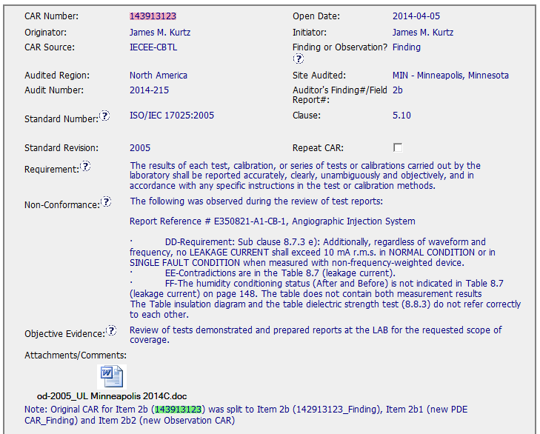
CAR 143913123
Fields filled out appropriately
The wording in the Non-Conformance field is a bit confusing , but it was a good idea to attach the report that the auditor had issues with.

Slide 3
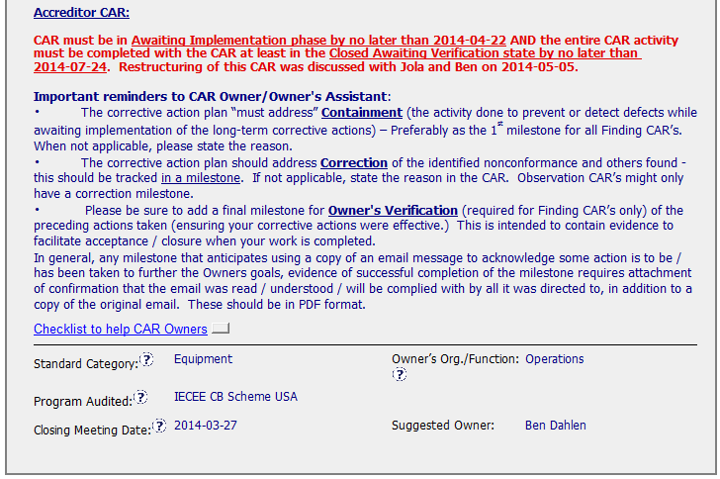
CAR 143913123
Guidance to CAR Owner is complete, accurate and helpful
Standard Category should be ‘Records’

Slide 4
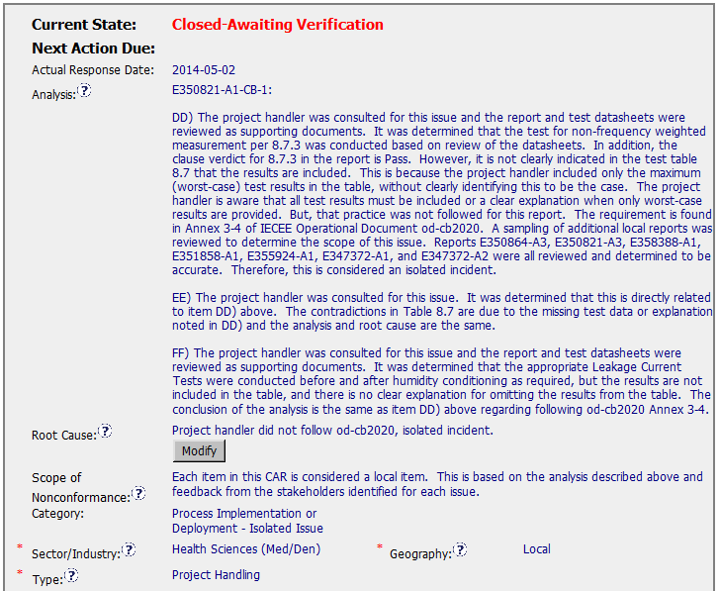
CAR 143913123
The Analysis field is detailed but does not state the name of the stakeholder

Slide 5
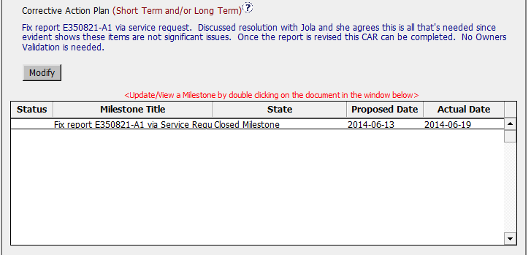
CAR 143913123
This CAR is a Finding , so a verification need to be inserted or it could be changed to an Observation

Slide 6
CAR 143913123 - CBS
INTEGRITY: Initiative & Decision Making / Analyzing & Problem Solving
Facilitates progression of the CAR through closure: extensions, escalations, reassignments, etc. (+)
Accurately completes the administrative fields within the CAR such as root cause category, process impacted, geography, etc. (+)
Acts on CARs within the required timeframe (+)
Most appropriate ‘category’, ‘type’, ‘geography’ are selected (-)

Slide 7
CAR 143913123 - CBS
COMPETIVENESS: Customer Focus / Achieve Business Results / Flexibility
Assists customers as they address all aspects of the CAR – analysis, root cause statement, milestone, containment, verification, etc. (+)
Verifies CARs timely (+)
Analysis shows clear path to root cause and scope; stakeholders identified (+)(-)
Root cause statement is succinct, reasonable, complete (+)
Corrective actions fix the objective evidence and other problems found; address entire root cause and scope. (+)
(C) Milestones address containment & owner’s verification; completed per milestone expectations(-)
(P) Verification per requirements (+)
COLLABORATION: Leading & Engaging / Teamwork / Communication
Provides pertinent feedback at appropriate times; shares information and keeps others informed (+)

Slide 8
CAR Champion Calibration Meeting CAR Review
Team “B”
Tovia Bat-Leah (CAR 143913123 Finding)
Jeff Lietz (CAR 143912892 Finding)
Kathy Lindstrom (CAR 143913435 Observation)
Jeff Lietz (CAR 143913094 Exemplary)

Slide 9
CAR 143913123 Finding
Presented by Tovia Bat-Leah

Slide 10
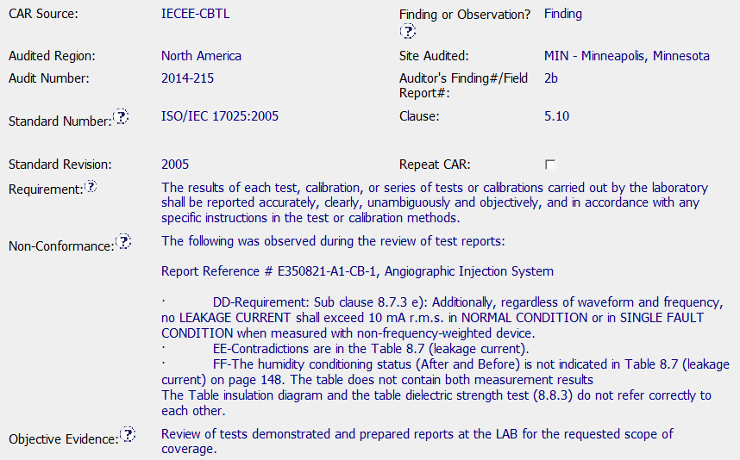

Should this be records?

Slide 11
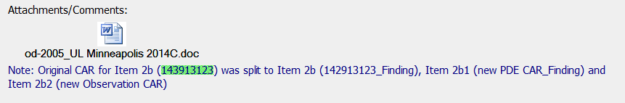
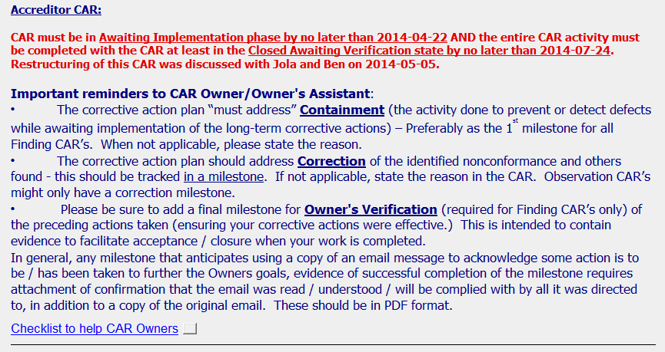
Maybe this is not the whole picture
Lots of good direction

Slide 12
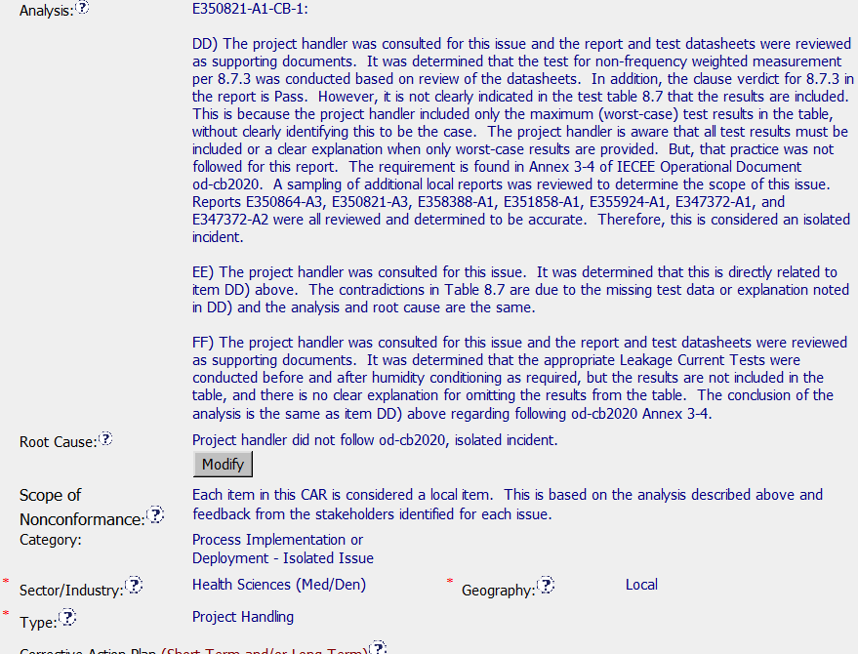
Who participated in the analyses, what is the scope of the issue did they look at other projects?
Notes:
Who participated in the analyses, what is the scope of the issue did they look at other projects?

Slide 13
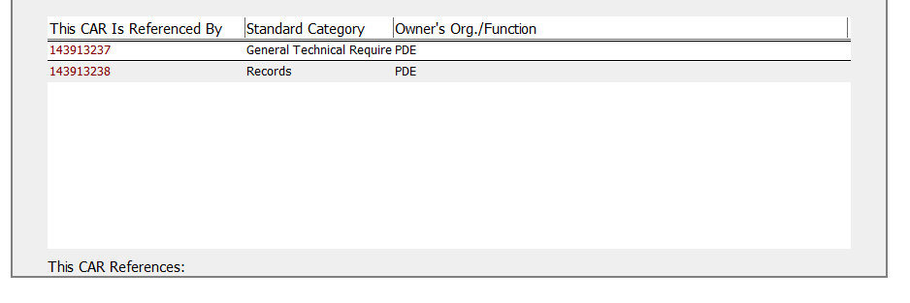
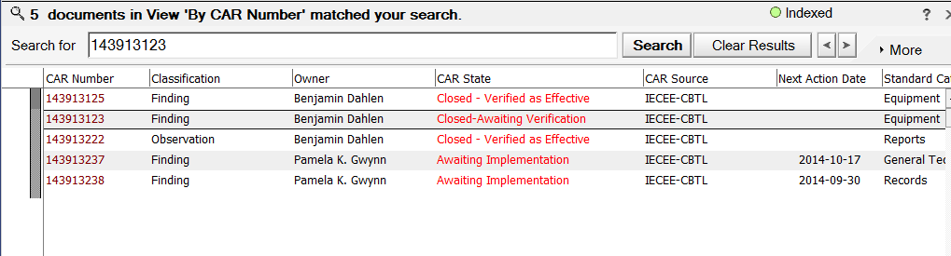
They split this CAR up into how many? Why? No additional information in attachments or notes, why is one closed as effective when not all are even complete?
5 CARs in various states as a result
Notes:
They split this Car up into how many? Why? No additional information in attachments or notes, why is one closed as effective when not all are even complete?

Slide 14
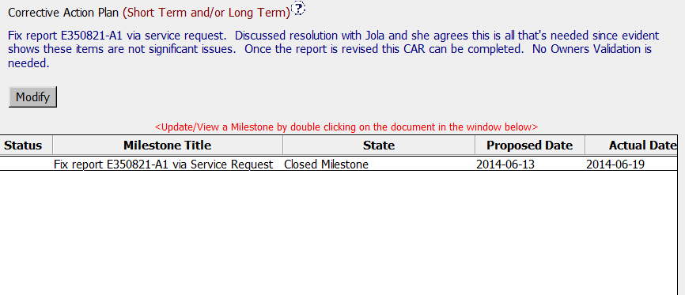
This is a finding, it is being treated like an observation

Slide 15

What will we base the Car verification on when the time comes?

Slide 16
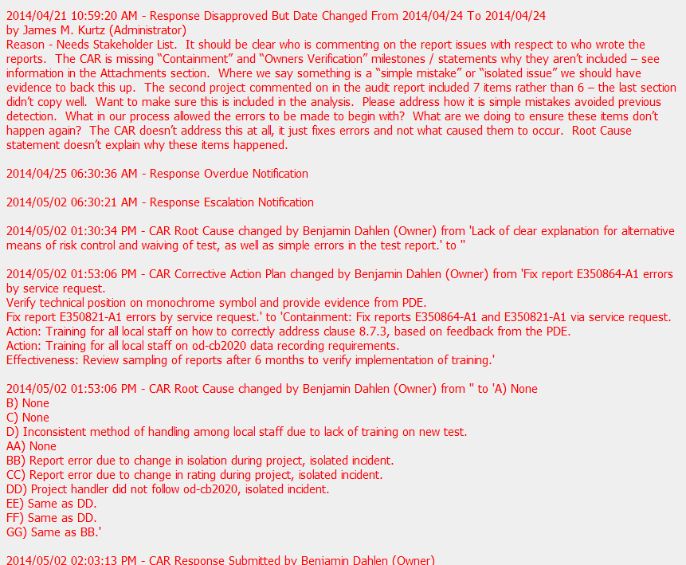
Looks like the admin asked for the right stuff but they never did get it from the CAR owner
Notes:
Looks like the admin asked for the right stuff but they never did get it

Slide 17
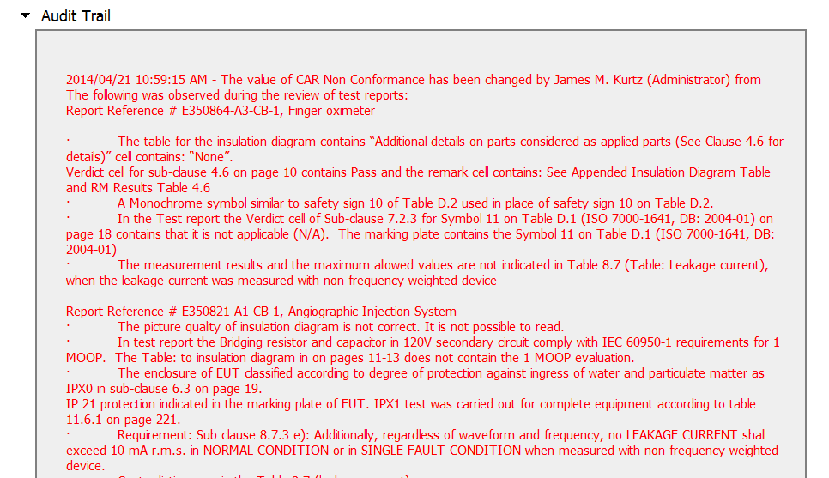
Lots of changes but no explanation as to why, it is not clear what the acreditor is looking for and if they ever got it
Notes:
Lots of changes but no explanation as to why it is not clear what the acreditor is looking for and if they ever got it

Slide 18
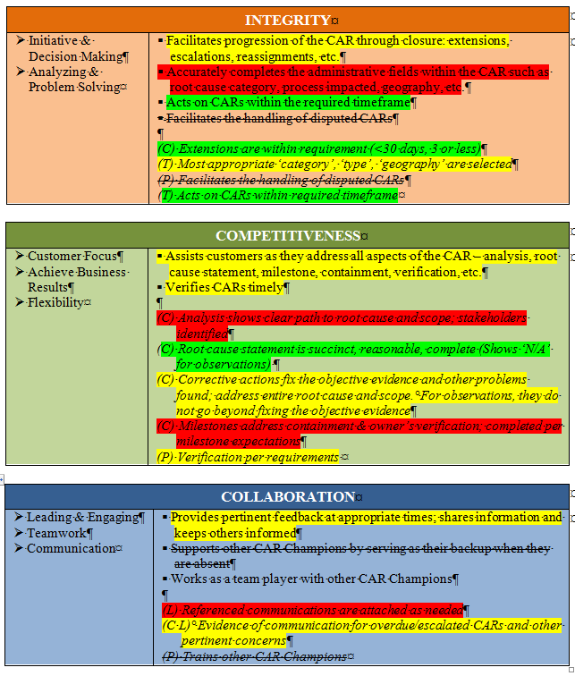
CBS Score Card
Analysis CAR not clear
Effectiveness Questionable

